Slide 1

CSE3151
Computer Networks
(Session 2018-19)
Dr. Asif Zaman
Associate Professor, CSE, RU

Slide 2
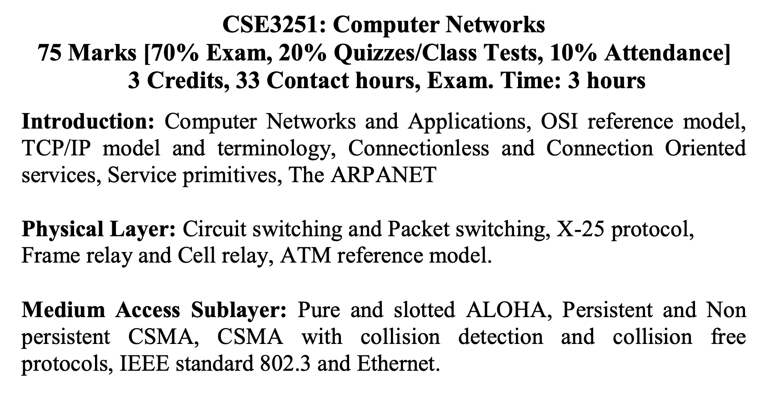
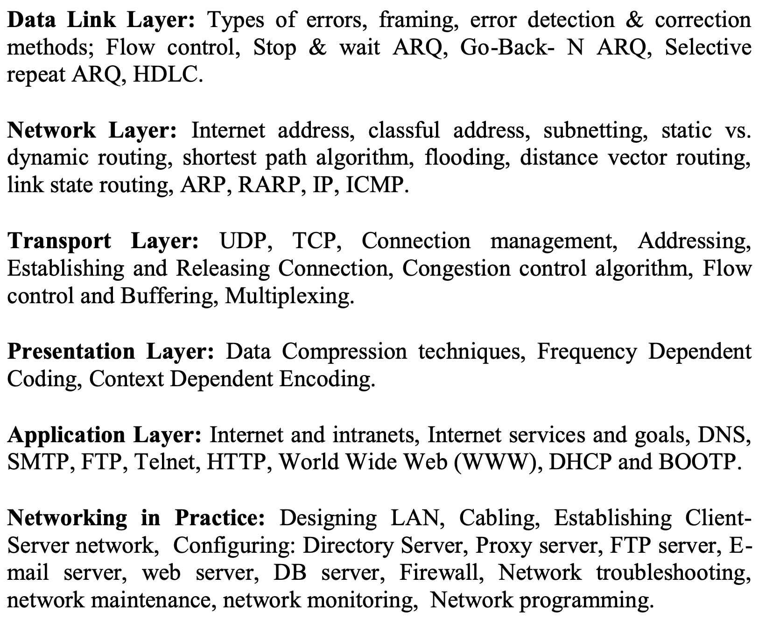

Slide 3
Physical Layer
Transmission medium
Guided Transmission Medium
Unguided Transmission Medium
Switching
Circuit switching
Packet Switching

Slide 4
Transmission Medium
Guided Transmission Medium
Magnetic Media or removable media
Twisted Pair
Coaxial Cable
Fiber Optics
Unguided Transmission Medium (wireless transmission)
Radio
Infrared
Ultrasound
…

Slide 5
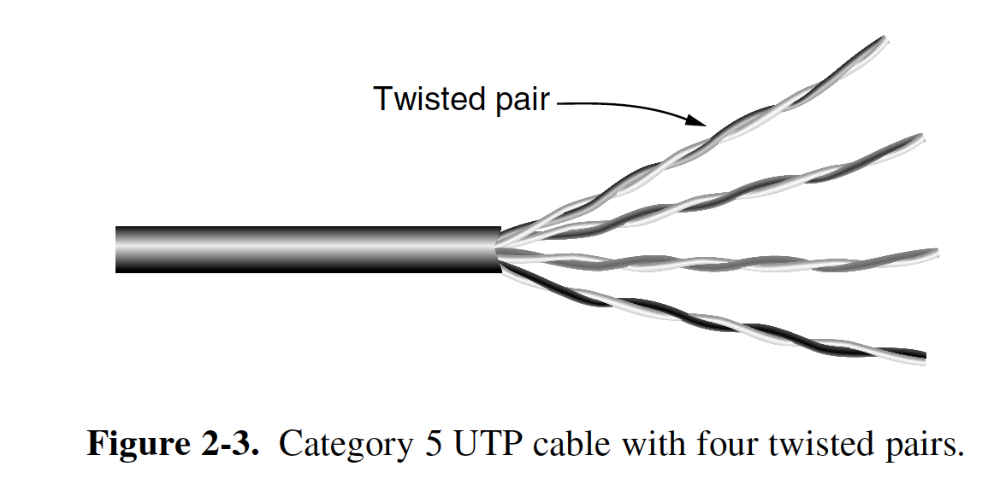
Transmission Medium
Magnetic Media or removable media
SSD (Solid State Drive)
DVD
HDD – few TB
Twisted Pair
UTP (Unshielded Twisted Pair)
Cat 6 – Gbps
Full Duplex
Half-Duplex
Simplex

Slide 6
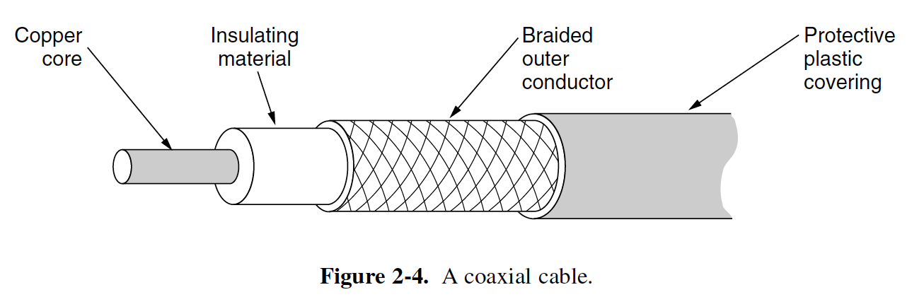
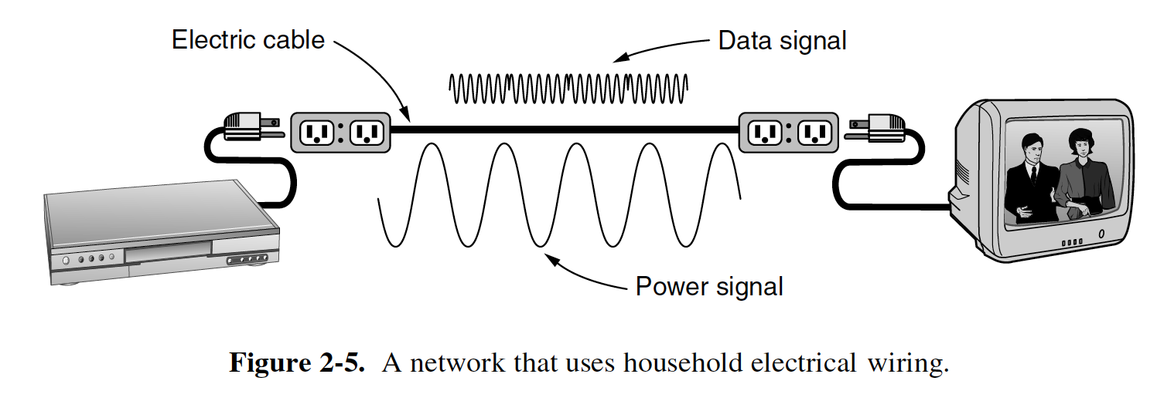
Transmission Medium
Coaxial Cable
Power Lines
Some Issues
Power 50-60 Hz &Data MHz range
Switch on-off – data bounce
Power Line works as Antenna

Slide 7
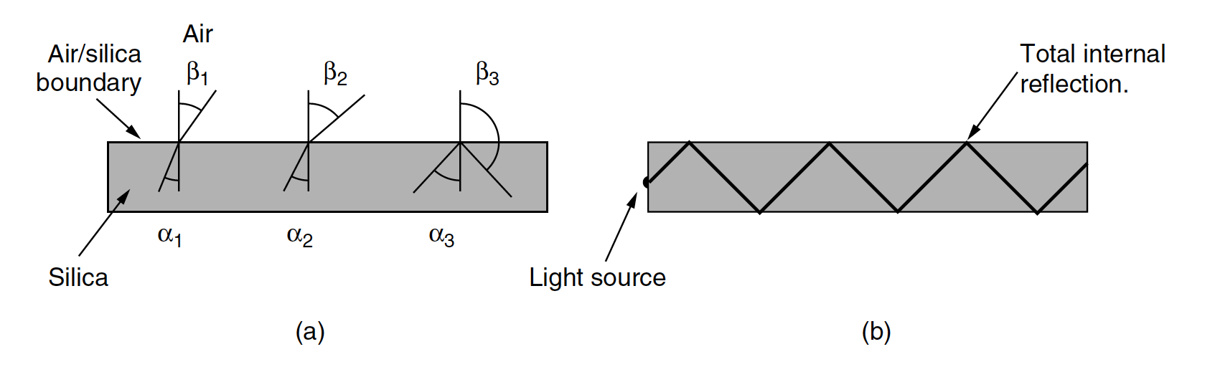
Transmission Medium
Fiber optics:
High speed communication medium
Up to 50,000 Gbps
Long Range
Using Light

Slide 8
Single Mode vs Multi Mode Fiber

Slide 9
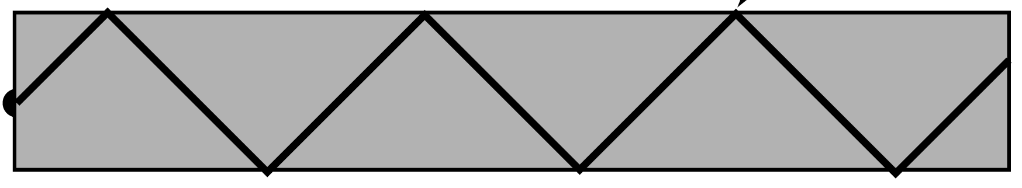
Single Mode vs Multi Mode Fiber
Multimode fiber…
Single mode fiber…
available single-mode fibers can transmit data at 100 Gbps for 100 km without amplification

Slide 10
Single Mode vs Multi Mode Fiber

Slide 11
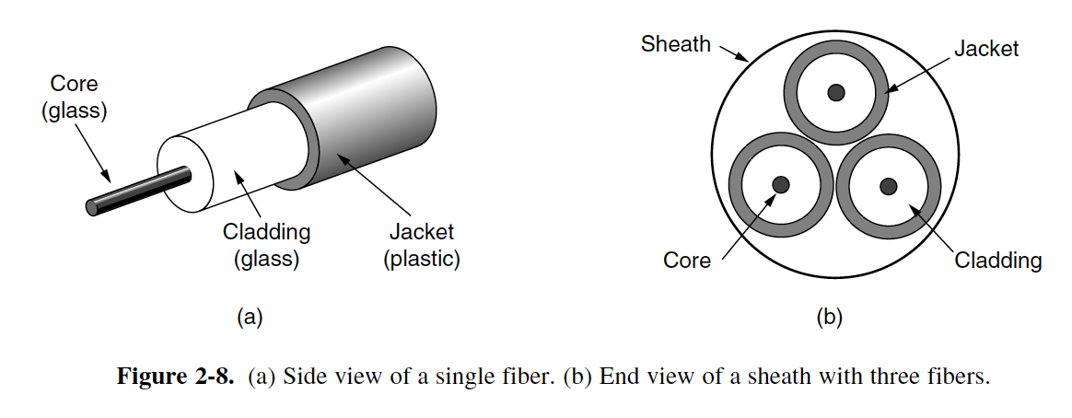
Transmission Medium
Fiber Cable:

Slide 12
Fiber vs Copper Media
Bandwidth
Fiber it can handle much higher bandwidths than copper. This alone would
Repeater distance
50 km vs 5 km
Environmental issue
Fiber …not being affected by power surges, electromagnetic interference, or power failures.
Resale value
Fiber has no/less resale value but copper has
Weight
Maintenance Cost
Security

Slide 13
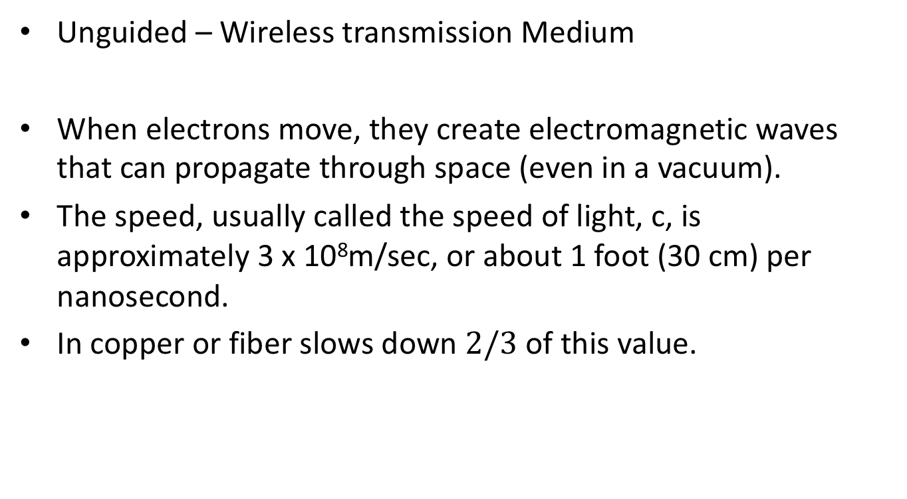
Transmission Medium
Unguided – Wireless transmission Medium
When electrons move, they create electromagnetic waves that can propagate through space (even in a vacuum).
The speed, usually called the speed of light, c, is approximately 3 x 10⁸m/sec, or about 1 foot (30 cm) per nanosecond.
In copper or fiber slows down $2/3$ of this value.

Slide 14
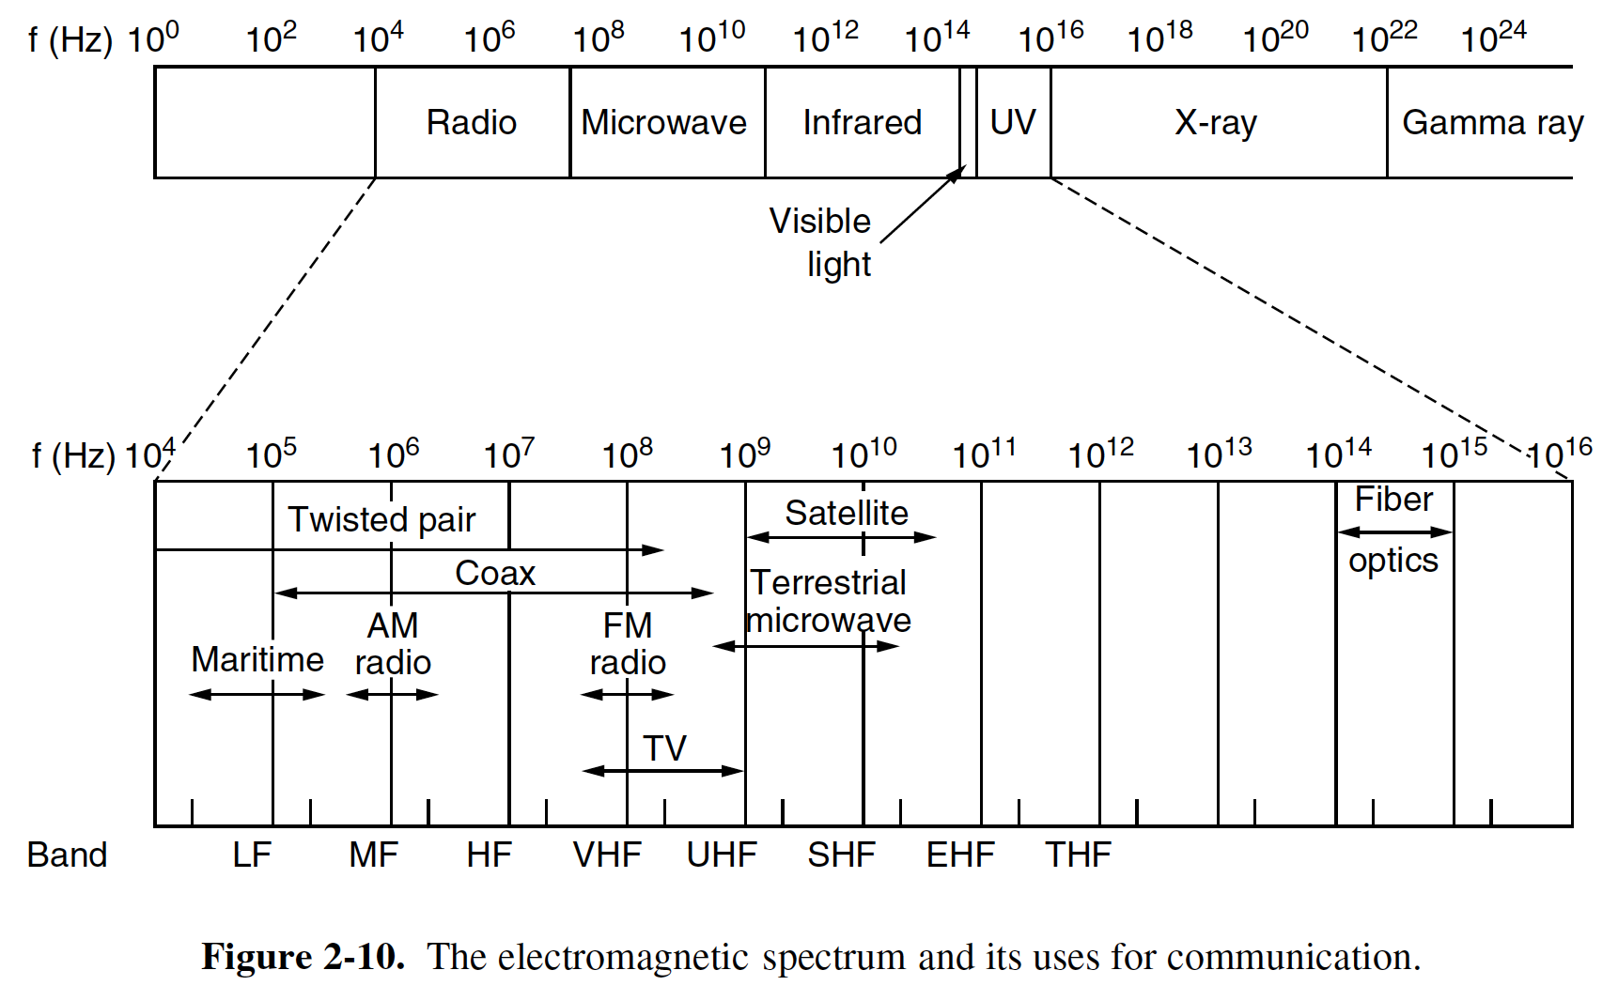
Transmission Medium
Incredibly, Astonishingly, and Prodigiously High Frequency (IHF, AHF, and PHF)

Slide 15
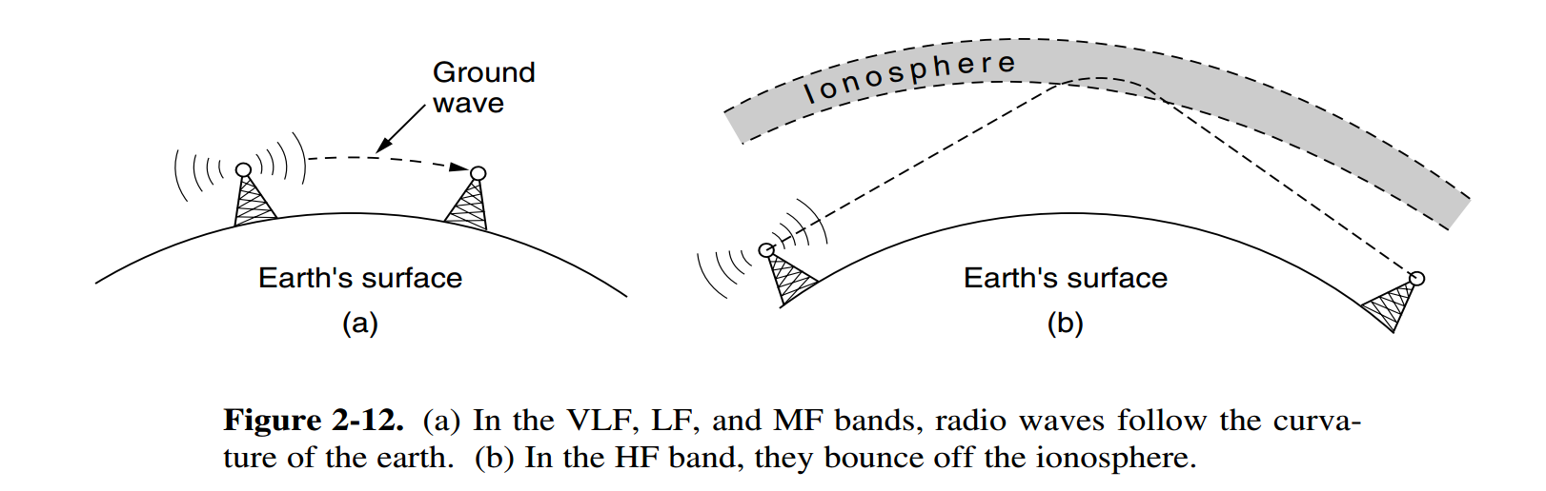
Radio Transmission
a layer of charged particles circling the earth at a height of 100 to 500 km, are refracted by it and sent back to earth,

Slide 16
Microwave Transmission
Above 100 MHz, the waves travel in nearly straight lines and can therefore be narrowly focused
The distance between repeaters goes up very roughly with the square root of the tower height.
For 100-meter-high towers, repeaters can be 80 km apart
microwaves do not pass through buildings.
Antennas needed to be aligned

Slide 17
Infrared Transmission
Widely used for short-range communication.
The remote controls used for televisions, VCRs, and stereos all use infrared communication
major drawback: they do not pass through solid object

Slide 18
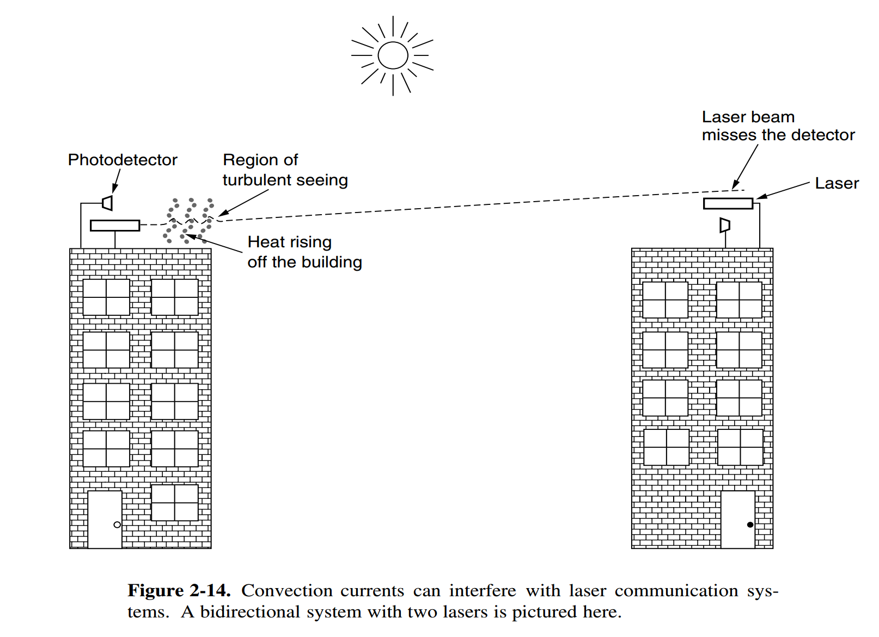
Light Transmission

Slide 19
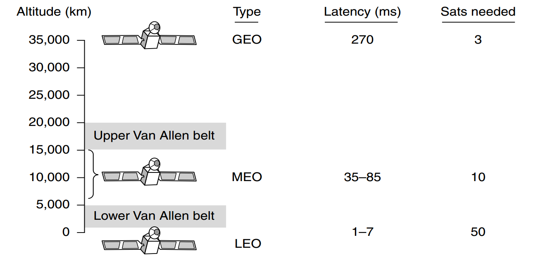
Communication Satellite
GEO- geosynchronous, or geostationary, earth orbit

Slide 21
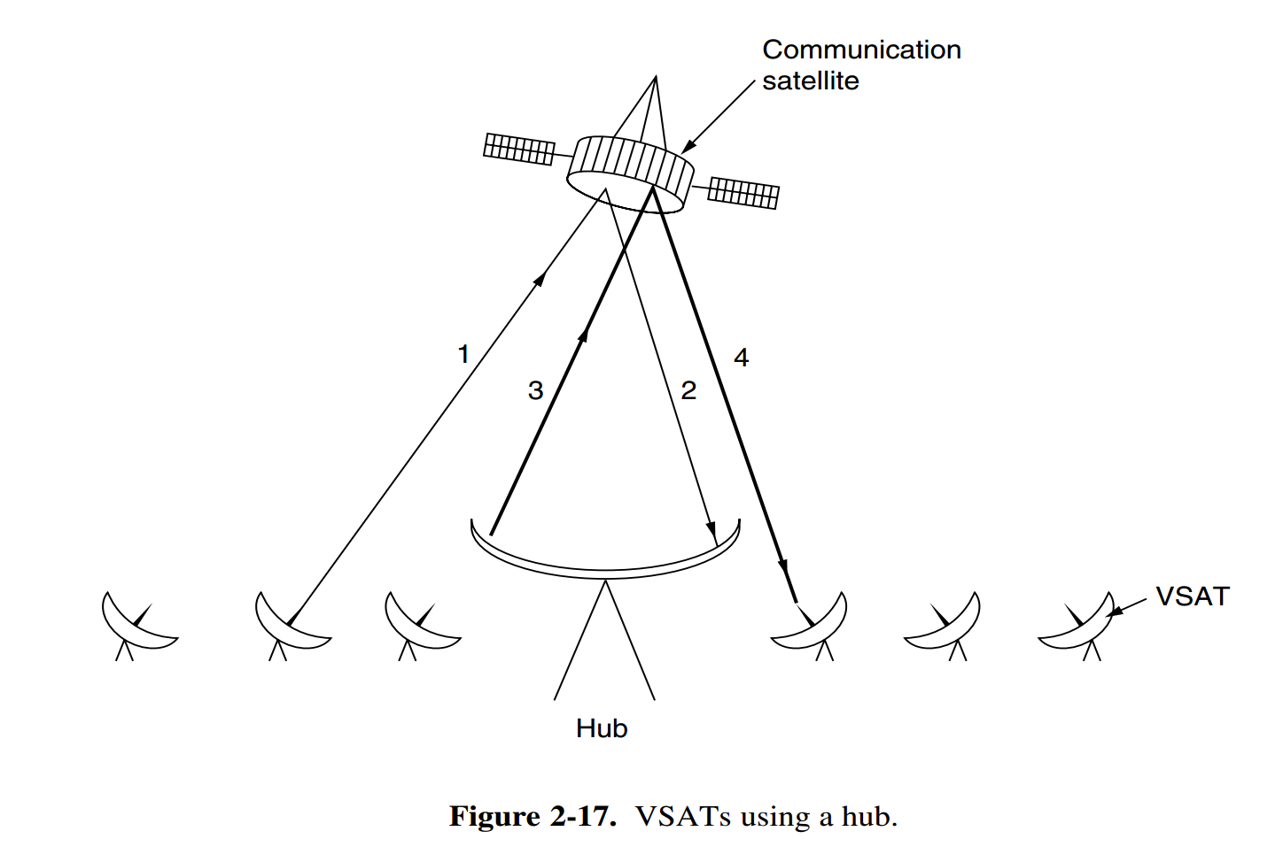
Communication Satellite

Slide 22
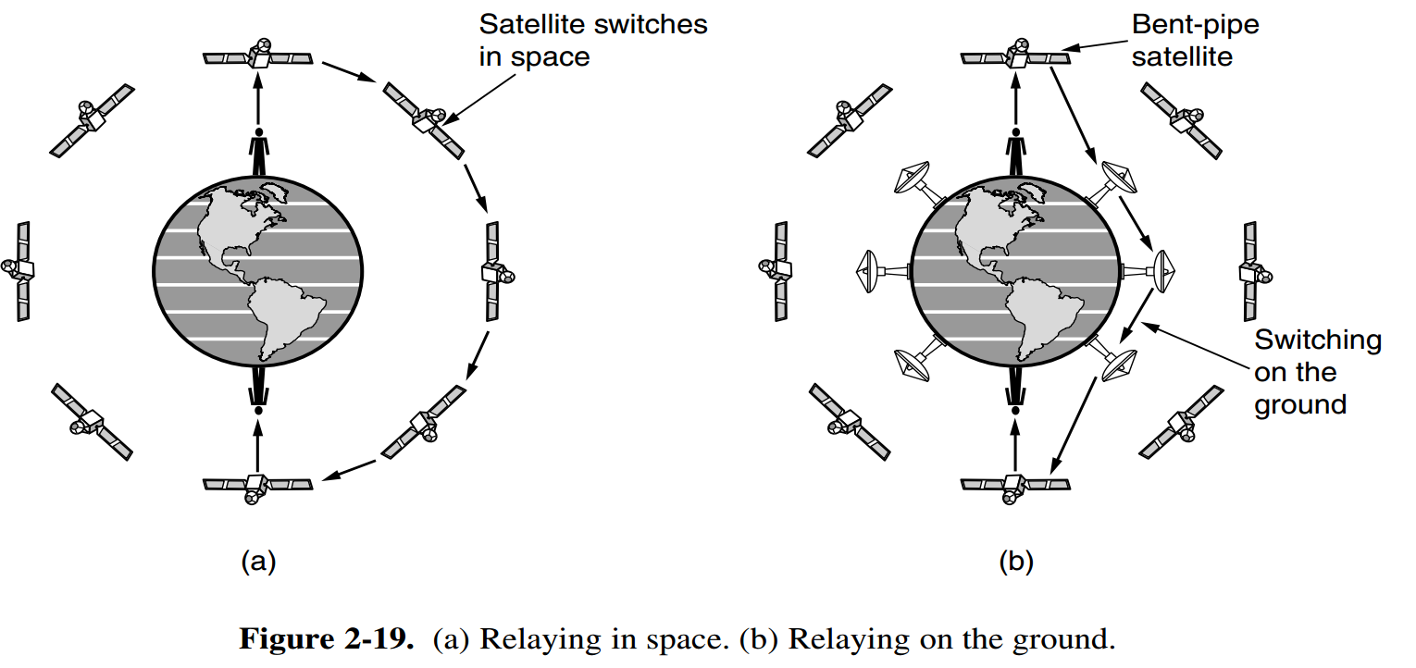
Communication Satellite

Slide 23
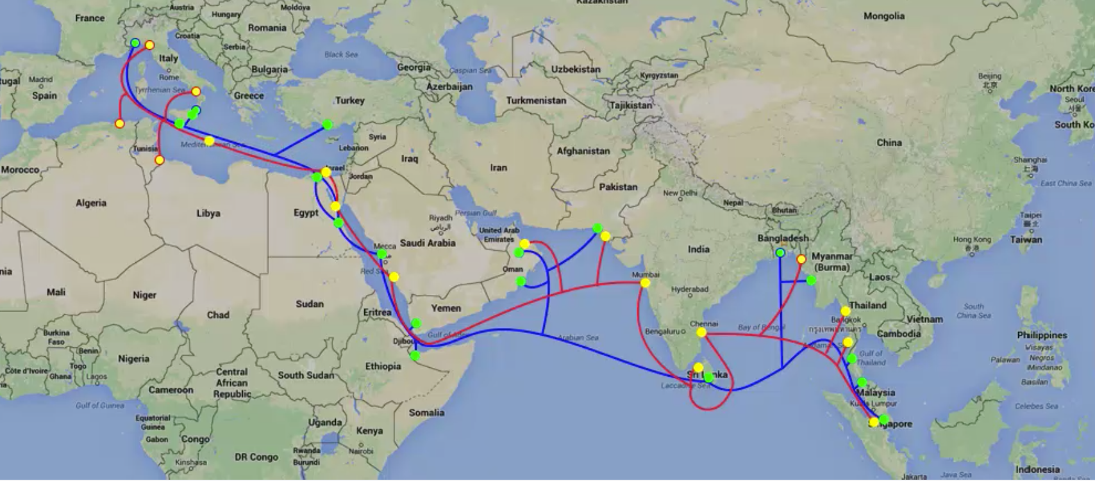
Basic Internet Structure

Slide 24
Basic Internet Structure

